Slide 1
Embedded Systems Projects
ASSET : A Methodology for Automated Synthesis of Embedded Systems
ASSIST : ASIP Synthesis Methodology Project
Prof. M. Balakrishnan
Department of Computer Science & Engineering
IIT Delhi
2nd August 2002

Slide 2
Project people
Faculty
Prf. M. Balakrishnan
Prof. Anshul Kumar
Prof. Subhashis Banerjee
Prof. Prem Kalra
Ph.D. students
Manoj Kumar Jain
Rajeshwari Banakar
Basant Kumar Dwivedi
M.Tech. Students 5
U.G. students 10

Slide 3
Outline
Objectives
Application and target architecture
ASSET Methodology
Estimations (HW, SW & Interface)
Partitioning
Synthesis
ASSIST Methodology
ASIP design space exploration
Conclusions
Future work
Publications

Slide 4
Objectives
Drive towards automated system design
Computation dominated embedded systems
Develop a methodology for exploring the design space in synthesizing an application specific instruction set processor (ASIP)
The motivation has been to
  develop a flow
  integrate public domain tools where available
  identify and conduct research in emerging area

Slide 5
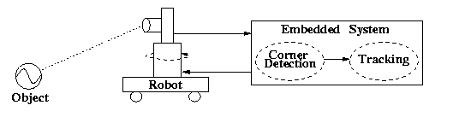
Application and Target Architecture
Application: Real time vision and image processing
ASIC
ASIC
Processor
ASIC
ASIC
Target Architecture

Slide 6
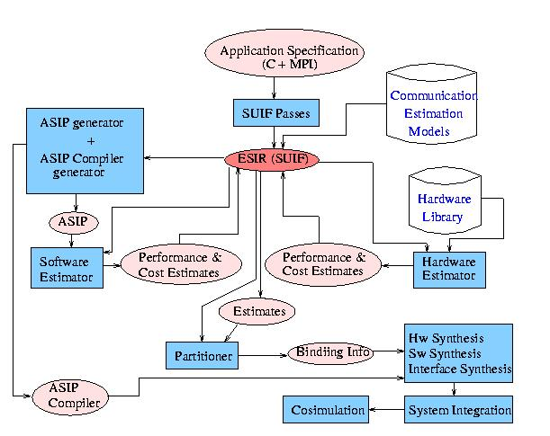
ASSET Methodology
ASSIST

Slide 7
Hardware Estimation
Application IR
Target technology
  FPGA
  ASIC
Estimation of
  Clock
    using slack minimization
  Bounds on execution time
    Upper bound: modified operator use method
    Lower bound: mobility based method
  Area
CDFG
Formation
Basic Block
Formation
Clock
Execution time
Area

Slide 8
Software Estimation
Inputs
  Application IR with profile information
  Machine description (resources + delays)
    FU to instruction binding
    Number of FU of each type
    Number of registers
    Slot information of operations
Output
  Estimated performance

Slide 9
Software Estimation Flow
Specification
Parameter
Extraction
Profiling
Processor
Library
Processor
Selection
Performance Estimation
Constraint Scheduler
Constraints
Processor
Description
Estimates

Slide 10
System Level Performance Estimation
Statistical model
of the application
Architecture
description
Simulator
Generator
Parameterized
Component Library
Performance
figures

Slide 11
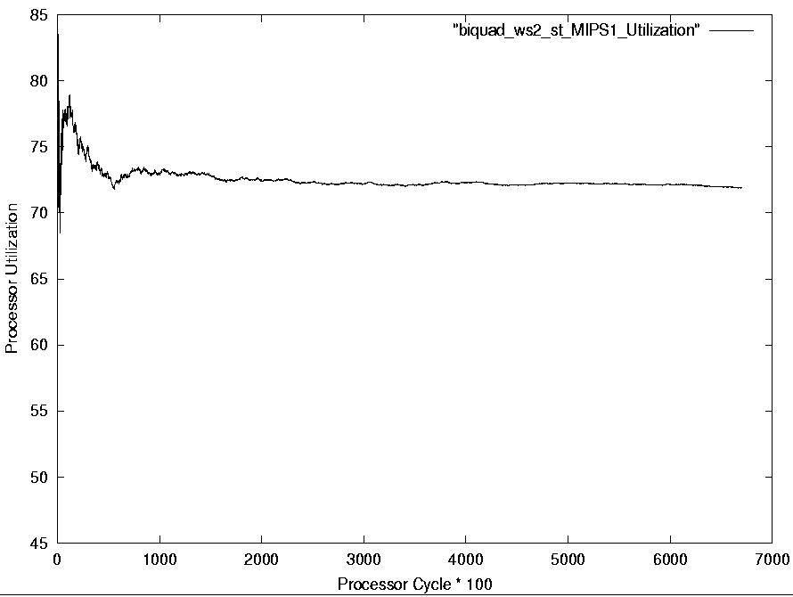
System Level Performance Estimation (cont.)
Fast simulation convergence example

Slide 12
Communication Estimation
Objective
  Estimating communication time requirements from process-resource mapping and architectural inputs
Communication models over PCI
  Pentium - Trimedia communication
  Pentium - FPGA communication

Slide 13
Partitioning
Process/function level partitioning
Inputs:
  HW, SW and communication estimates
Scheduling and binding of tasks onto hw & sw resources
Objective function:
  to minimize execution time or to meet specific time constraints
Problem modelling
  Linear programming
  Dynamic programming

Slide 14
Synthesis
Hardware synthesis
  C-to-VHDL translator
Software synthesis
  Standard compilers
Interface synthesis
  Standard buses and manual transformations
Kernel synthesis

Slide 15
Real Time Kernel Synthesis
Features
  Modular, Portable Kernel
    Modular, Portable Kernel
    Isolation of Architecture/CPU dependent code
  Pluggable Scheduler
  Two level Interrupt Handling
  Support for multiprocessor environment

Slide 16
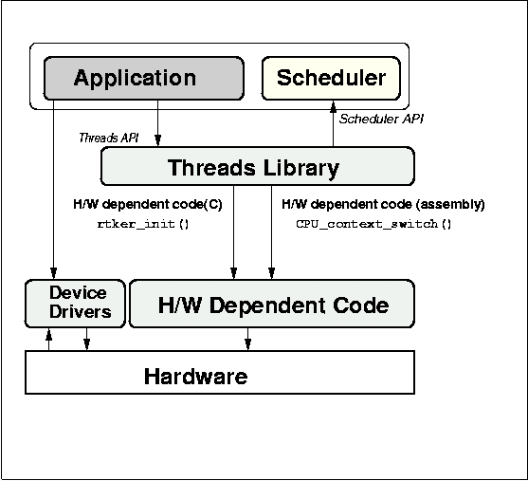
Real Time Kernel Synthesis (cont.)
Real Time Kernel Block Diagram

Slide 17
ASSIST: Methodology
Register size evaluation
Register windows exploration
Cache-Scratchpad
Custom Fus and co-procs
Application &
Design Constraints
Application Analysis
Leon Processor Syn.
Area and
Clock period
data
Architectural Design Space
Exploration
Code Synthesis
Hardware Synthesis
Object Code
Processor Description

Slide 18
Register Size Evaluation: Problem Definition
Fast performance estimation with varying register file sizes in a scheduler based approach
Register file size evaluation based on performance estimates, suitable cost models and constraints

Slide 19
Register Size Evaluation: Motivating Study
Study the impact of changing the number of
registers on
Performance (# cycles), Power, Energy and Code size
Experimental Framework
C Code
encc
assembly
Assembler &
Linker
executable
energy
database
profiling
information
trace
analyzer
trace file
ISS

Slide 20
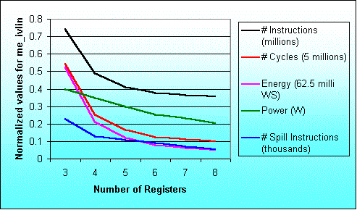
Result for the program me_ivlin
knee due to exec. time reduction
knee due to power saving

Slide 21
Maximum variation in results
Benchmark Program | Performance |  | Power |  | Energy
 | Reg. size | % inc. | Reg. size | % red. | Reg. size | % red.
biquad_N_sections | 3 → 4 | 57.5 | 3 → 4 | 12.6 | 3 → 4 | 62.9
lattice_init | 4 → 5 | 20.5 | 6 → 7 | 1.0 | 4 → 5 | 21.0
matrix-mult | 3 → 4 | 29.7 | 7 → 8 | 7.4 | 3 → 4 | 33.4
me_ivlin | 3 → 4 | 53.4 | 5 → 6 | 15.3 | 3 → 4 | 59.3
bubble_sort | 4 → 5 | 46.3 | 4 → 5 | 17.3 | 4 → 5 | 55.6
heap_sort | 6 → 7 | 25.6 | 6 → 7 | 10.3 | 6 → 7 | 33.2
insertion_sort | 4 → 5 | 44.8 | 4 → 5 | 22.3 | 4 → 5 | 57.1
election_sort | 3 → 4 | 22.2 | 5 → 6 | 14.0 | 5 → 6 | 30.1
Average |  | 37.5 |  | 12.5 |  | 44.1

Slide 22
New Technique for Register File Size Evaluation
Scheduler based approach
Code generator as well as simulator not required
Fast compared to simulator based techniques
Validated for ARM7TDMI, TM-1000 and Leon
Simple machine description
Retargetable

Slide 23
Register file size evaluation methodology
Application
Profiling
SUIF
Profile information
SUIF IR
Processor description
Dependence analysis
Control flow graph
Data flow graph
Local register allocation
using reuse chains
Estimate overhead to
handle global needs
Modified data flow graph
Local execution time estimate
Schedule overhead
due to global needs
Scheduling
Schedule estimate of single
execution of the basic block
Execution time estimates

Slide 24
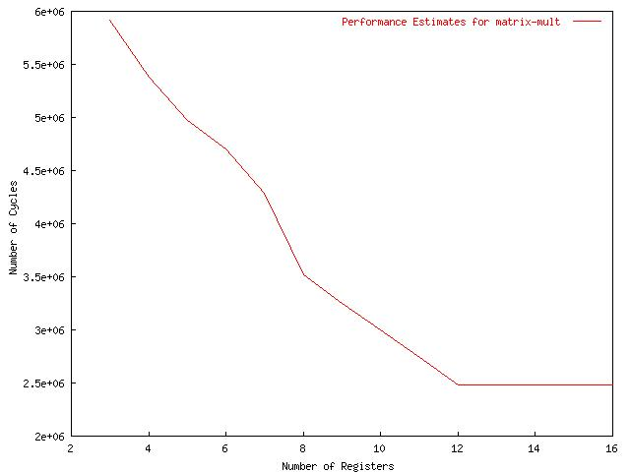
Excution time for matrix-mult with diff. Register file sizes for ARM7TDMI

Slide 25
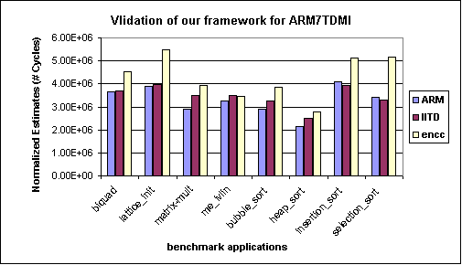
Validation of ASSIST for ARM7TDMI processor

Slide 26
Register Windows Evaluation: Problem Definition
Performance analysis for the
ASIP parameter,
number of register windows

Slide 27
Overlapping Register
Overlapping Registers
W3 outs
W0 ins
W3 locals
W2 outs
W3 ins
W0 locals
W2 locals
W0 outs
W1 ins
W1 outs
W2 ins
W1 locals

Slide 28
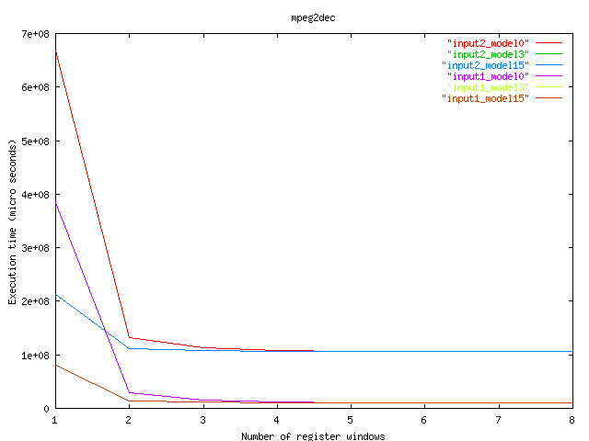
Execution time for MPEG Decoder

Slide 29
Cache v/s Scratchpad : Objectives
Develop a systematic framework to evaluate area, performance and energy of cache/scratch pad based systems
Develop the area model for varying sizes of cache/scratchpad memory
Performance model
Energy model

Slide 30
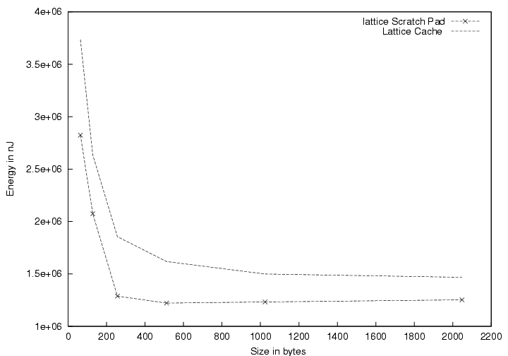
Energy Consumption for lattice filter
Cache
Scratch pad

Slide 31
Leon Synthesis Objectives
Synthesize Leon processor for different configurations
Generate a database of area and clock period for different configurations to assist in ASIP design space exploration
Identify and incorporate more architectural features

Slide 32
Exploring Design-Space of VLIW ASIPs
Spectrum of Custom FUs
  Multiple Input Single Output (MISOs)
  Multiple Input Multiple Output (MIMOs)
  I/O timeshape - rigid or flexible
  MIMOs with load/store
Retargetable optimizing compiler/simulator needed
Trimaran can be used but needs to be suitably augmented
  Imposition of register file port constraints
  Modeling pipelined functional units
  Support for introduction of application specific functional units
  Support for FUs with memory interaction

Slide 33
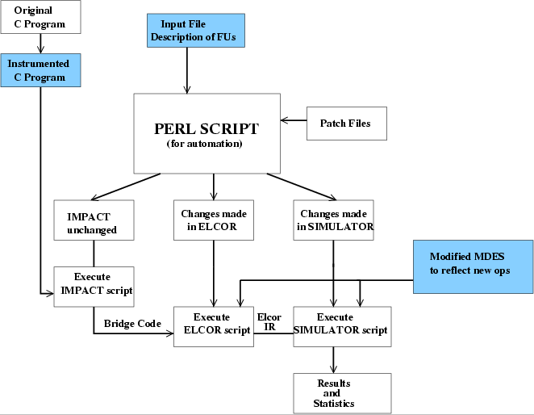
Augmented Trimaran Framework

Slide 34
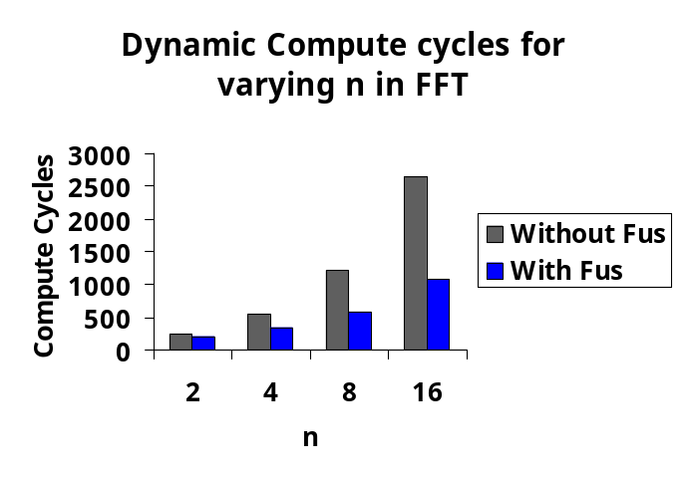
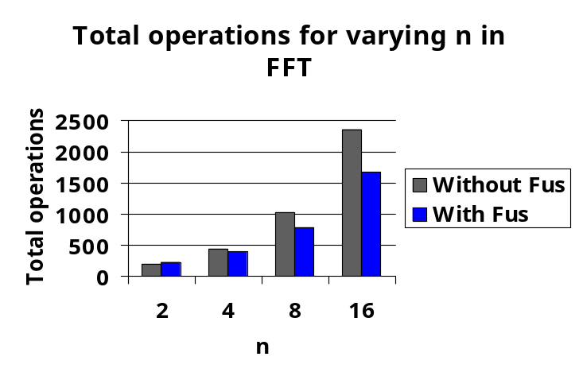
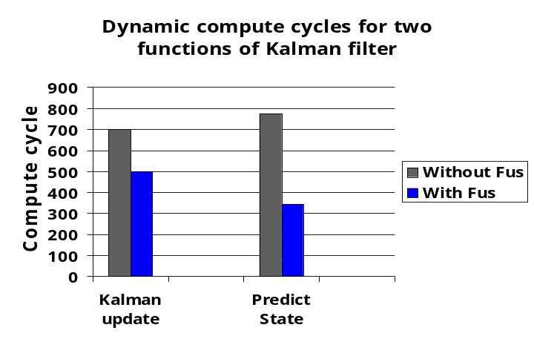
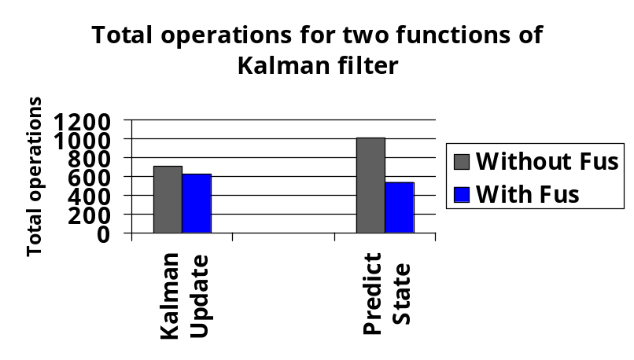
Results

Slide 35
Automatic Coproc and Interface Generation for ASIP Synthesis
Automatically generate synthesizable VHDL for application part mapped to hardware
Automatically augment the application code to utilize this dedicated hardware
Library driven support for various interfaces
Smart handling of division and multiplication along with simple bit width analysis
Tested as a coprocessor to LEON (a Sparc V8 compliant soft processor core) and Host-FPGA interfaces

Slide 36
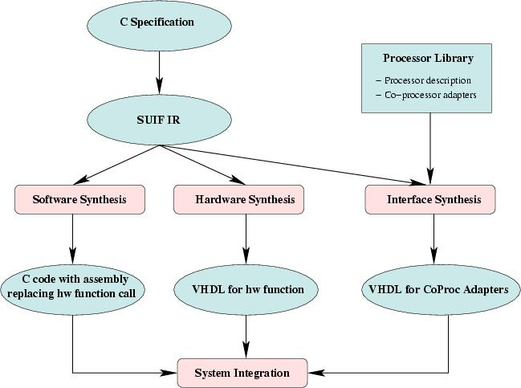
Overall Translation Methodology

Slide 37
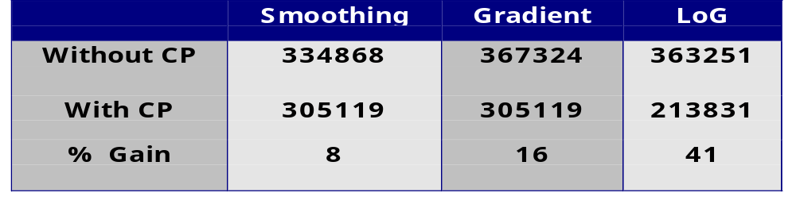
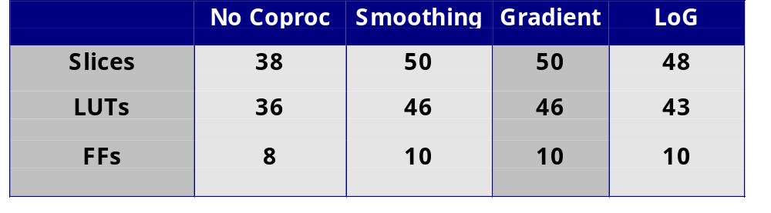
Results
Cycles required for operation on 64x64 image
Percentage Resource utilization on XCV-800

Slide 38
Conclusions
Methodology for automated synthesis of embedded systems
Software, hardware and interface estimation techniques developed
Algorithm for hardware software partitioning
C-to-VHDL translator
Real time kernel synthesis
Fast system level design space exploration

Slide 39
Conclusions contd.
Register File Size evaluation
Impact of number of register windows on performance
Trade off between scratch-pad and cache memories for ARM and LEON processor
Area and clock period results by various LEON configurations

Slide 40
Future Work
An extensive case study to illustrate the methodology
Application specific Multi Processors
Multiprocessor prototype on FPGA using LEON processor
VLIW ASIP synthesis

Slide 41
Publications
Software estimation VLSI 2000
Hardware estimation IITD technical reports
Partitioning VLSI 2000
Communication estimation VLSI 2001
Real time kernel IITD technical reports
System level performance estimation ISSS 2002
Register file size CASES 2002, IEEE TCAD Nov.2001, CODES 2001, SCOPES 2001
Scratch-pad vs. cache CODES 2002, ISSS 2002
Register windows VLSI 2002
Customized Fus for VLIW ASIPs ISSS 2002

Slide 42
Acknowledgements
NRB, Govt. of India for ASSET project
DST, Govt. of India and DAAD, Govt. of Germany for ASSIST project

Slide 43
For further details please visit
http://www.cse.iitd.ernet.in/esproject
Thanks

Slide 44
Methodology : ASSIST Flow
Application
Constraints
Profiler
Parameter
Extractor
Application Parameters
Basic
Processor
Config.
Component
Power
models
Configuration
Selector
Processor
Pipeline +
models
# of clocks
Estimator
Power
Estimator
Area and
Clock Period
Estimator
Area and
Clock period
data
Processor
Configurations
Design Space Explorer
Retargetable
Compiler Generator
Synthesizable
VHDL Generator
ASIP Compiler
Synthesizable
VHDL

Slide 45
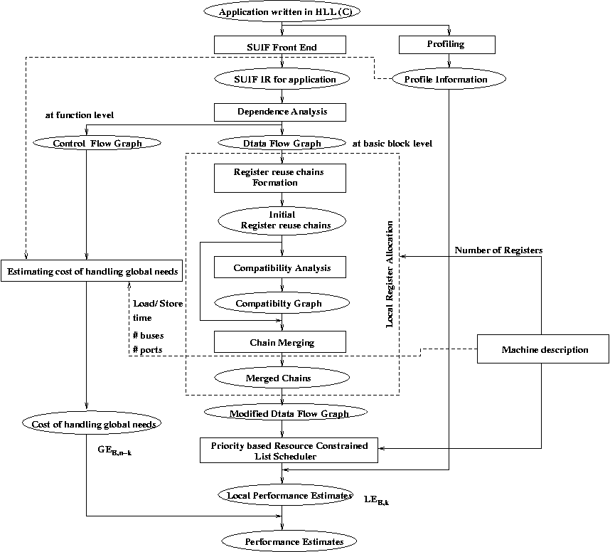
New technique for register file size evaluation (scheduler based)

